Slide 1
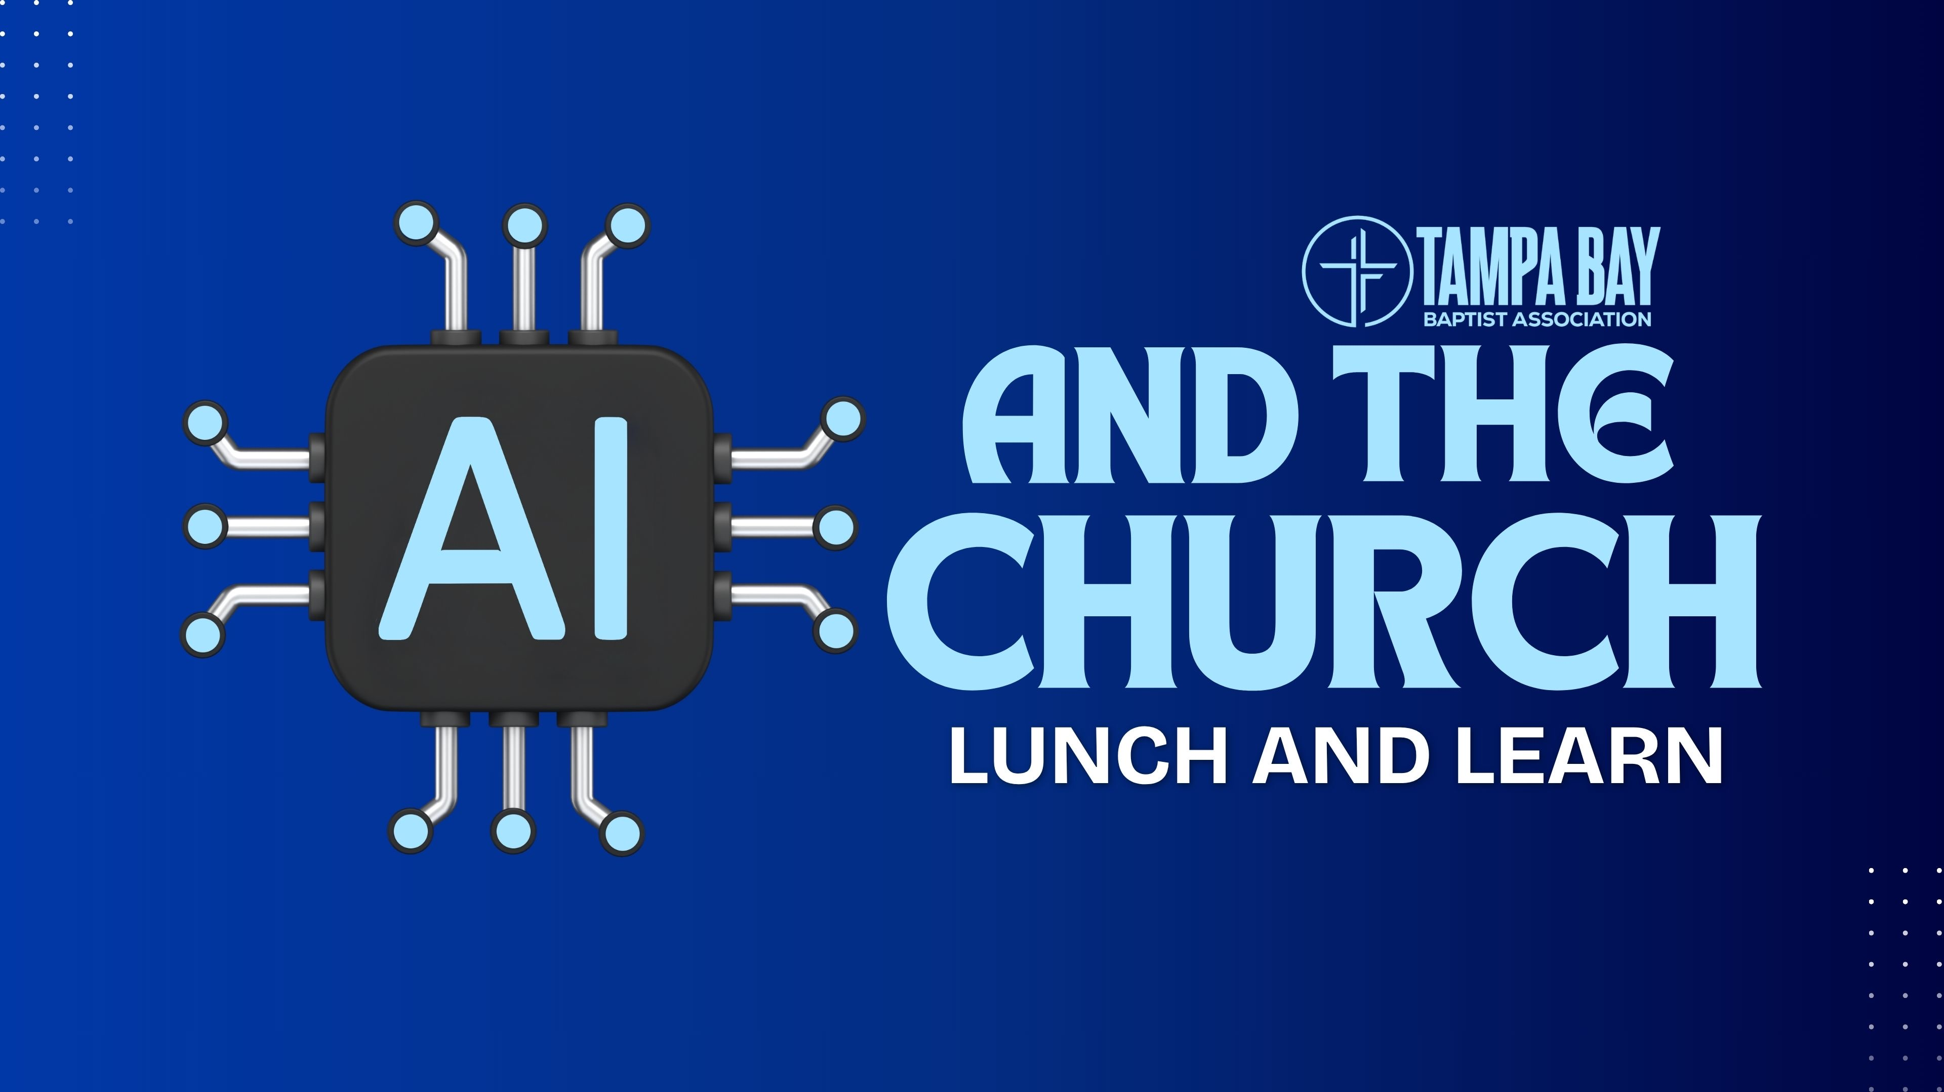

Slide 2
AI and the Church — Part 1
Tampa Bay Baptist Association · Idlewild Baptist Church · April 20, 2026
Angel R. Rojas, Jr. · COL (Ret.) Jobie Roach · DataCorps Technology Solutions
Notes:
Open warmly. Thank Idlewild Baptist for hosting and the Tampa Bay Baptist Association for the invitation.
This is Part 1 of a developing series. Today lays the foundation; Parts 2 (Practical Uses + Risks) and 3 (How to Get Started) will follow.
Set the room: about an hour. Questions welcome throughout; full Q&A at the end. Conversational, not lecture.

Slide 3
Your Presenters
Angel R. Rojas, Jr. — Founder & CEO, DataCorps. 30+ years in IT. FBI InfraGard Board Member Emeritus. U.S. Secret Service Cyber Crimes Task Force. Locally and nationally recognized by peers, published author, and thought leader. Ordained as a deacon at FBC Brandon. Attending Fellowship Baptist Church.
U.S. Army COL (Ret.) Jobie Roach — Director of Enterprise Strategy & Operations, DataCorps. 27 years U.S. Army. Chief of CENTCOM (MacDill) J4 Plans and Logistics Automation. Strategic Advisor to Army Chief of Staff & Chairman of the Joint Chiefs of Staff. Lean Six Sigma Black Belt. Life Group leader, FBC Brandon since 2002.
Notes:
Acknowledgments — thank by name from the stage:
- Lielson Penido — Corporate Chaplain, DataCorps. Spiritual partner in every major strategic conversation we have.
- Pastor Mark Pennick — First Baptist Church Brandon. Jobie's home-church pastor since 2002 and a faithful shepherd.
- Pastor Mike Grover — Fellowship Baptist Church. Angel's pastor. His Wednesday-night Bible study on The Importance of Word Meanings landed exactly at the right time for this talk — you will hear the echo later.
These men have shaped what you will hear today.

Slide 4

Why We're Here
You did not come for a "What is AI" talk. You can Google that.
You came because your congregation is already using the technology
66% of practicing Christians report AI is improving their lives (13 points above national average)
53% believe AI creates more problems than solutions
Notes:
Angel Presents
This is the premise of the hour. Pastors are here because your people are already in the machine — being discipled, often, through algorithms built by people who do not know or love them.
A pastor is already the primary interpreter of reality for a congregation. AI does not replace that role; it puts pressure on it.
Promise the payoff: a three-part frame, a physical prop, and something that will change how you see the tools on your own phone.

Slide 5
Why We're Here
Fears are not Irrational – 57% of Christians and 72% pastors view AI as a threat
54% of Christians and 79% of pastors pastors say AI exhibits bias
Note the 72% vs. 56% gap – Acts 20:28 – “Holy Spirit has made you overseers”
Source: Barna’s April 2026 study – Christians View AI as a Gift-and a Threat
Notes:
Angel Presents
This is the premise of the hour. Pastors are here because your people are already in the machine — being discipled, often, through algorithms built by people who do not know or love them.
A pastor is already the primary interpreter of reality for a congregation. AI does not replace that role; it puts pressure on it.
Promise the payoff: a three-part frame, a physical prop, and something that will change how you see the tools on your own phone.

Slide 6
Begin With the End in Mind — Three Takeaways
When you walk out of this room, carry three things:
What it is (and the types) and what it’s not.
How it aligns with a Biblical worldview.
What our responsibility is.
Everything in the next hour serves these three.
You leave equipped to combat any fear, uncertainty, or doubt around the subject — the common marketing posture of the moment — and with a Biblical approach to this technology and anything derived from it.
Notes:
Angel Presents
'
The three takeaways are the promise: what it is, how it aligns, what our responsibility is. Everything serves these three.
Explicitly reject FUD (fear, uncertainty, doubt) as a marketing posture. That is how technology gets sold to the church; that is not how Scripture shapes us.
If nothing else lands, send them out with those three.

Slide 7
Words Have Meanings — Intelligence · Artificial · Augmented
Intelligence — the capacity to learn, reason, and apply knowledge.
Artificial — synthesized, man-made; implies autonomy, a parallel mind. There is no parallel mind.
Augmented — extended, amplified, enhanced. The human is still the author. The tool extends the hand.
The honest word for what we are discussing is Augmented Intelligence. Call it artificial and you treat it as other. Call it augmented and you remain responsible — and aligned with Scripture.
"What is man that you are mindful of him... you have given him dominion over the works of your hands; you have put all things under his feet." — Psalm 8:4–6
Notes:
Angel delivers.
Open with the personal anecdote: last Wednesday night in Bible study at Fellowship Baptist, Pastor Mike was walking through how to study a word in Scripture. Providentially timed.
Last Wednesday night in Bible study at my home church, Fellowship Baptist, my pastor — Pastor Mike Grover — was teaching exactly this: words have meanings, and words matter. The pastors in this room know the discipline. We are dealing with "Intelligence" here, and the words we use to describe it are not neutral.
Pastors in this room already know this discipline — seminary taught it. We are not teaching hermeneutics. We are naming a skill you have and pointing it at AI.
Vocabulary matters: Artificial implies a parallel mind (there is none). Augmented implies a human extension (there is one — you). The word we choose tells us who is responsible.
Psalm 8:4–6 anchor — dominion over the works of our hands. AI is the works of our hands. We remain responsible.

Slide 8
History of AI
AI is not new technology. The ideas have been around longer than some of us have been alive. What's new is the cost to use them.
1950 — Alan Turing asks, Can machines think?
1956 — "Artificial Intelligence" coined at Dartmouth.
1958 — Frank Rosenblatt's Perceptron — the first neural network.
1966 — ELIZA, the first chatbot. It fooled people. In 1966.
1980s — Expert systems enter medicine and finance; backpropagation matures.
1991 — War in the Age of Intelligent Machines – Manuel DeLanda
1997 — IBM's Deep Blue beats Kasparov.
2012 — AlexNet wins ImageNet. The math was not new — the Graphics Processing Units were.
Notes:
Jobie delivers. Opens Act 1's timeline.
What is technology?
The human augmentation of capacity. Every tool, from the plow to the printing press to the language model.
Pastors know Ecclesiastes 1:9 — "nothing new under the sun." AI fits this verse, not the exception to it.
Define technology upfront: the human augmentation of capacity. Plow. Printing press. Computer. Language model. All of these are augmentations of what humans could already do.
Walk the timeline briskly. The point is not the dates; it is the realization that AI is older than most people in the room.
Close with the AlexNet line — "the math was not new; the GPUs were." That earns the pivot to Slide 7.
"What has been is what will be, and what has been done is what will be done, and there is nothing new under the sun." — Ecclesiastes 1:9

Slide 9
The general public “discovers” AI
2017 — The Generative Pre-trained Transformer (GPT) architecture is "published" — more accurately, disclosed to the public record. It powers ChatGPT, Claude, Gemini.
2020 — GPT-3 proves scale works. Scale — not a new idea.
November 2022 — ChatGPT launches. 100 million users in 2 months — the fastest adoption of any technology in human history. Not because AI was new. Because it was finally free, fast, and accessible.
2023–Present — AI embedded in search, email, documents, phones.
This is not a moment of discovery. It is the moment a 75-year-old idea became cheap enough for everyone.
Notes:
Jobie delivers.
GPT stands for Generative Pre-trained Transformer.
It's the name of the AI model architecture developed by OpenAI:
Generative → It generates text (or other content) based on patterns it learned.
Pre-trained → The model is first trained on a massive amount of data before being fine-tuned for specific tasks.
Transformer → The underlying neural network architecture (introduced in the 2017 paper "Attention Is All You Need") that powers it.
The transformer architecture (2017) is the engine behind ChatGPT, Claude, and Gemini.
"Published" is in scare-quotes on purpose: what was disclosed publicly in 2017 was likely already in use longer than the public record acknowledges. Do not overstate, but do not pretend otherwise.
ChatGPT's 100-million-users-in-2-months number is the headline, but the real story is distribution, not discovery.
Land the line: "cheap enough for everyone." That frame carries the rest of the hour.

Slide 10
Types of AI — What's Public, What's Hinted At
Narrow AI (what we have publicly) — designed to do one thing well. Siri, spam filters, Netflix, ChatGPT, Claude. This is what your congregation uses.
General AI (AGI) — a machine that appears to reason across any domain, mimicking human qualities. Not publicly acknowledged to exist — but being hinted at. "Theoretical," per the public record.
Super AI (ASI) — a machine that surpasses all human intelligence. Science fiction… maybe. Not close… maybe.
What is publicly available is powerful. It is not thinking, feeling, conscious, or alive – it is synthetic.
What is not publicly available is a separate conversation — and one the church should be awake to – despite the appearance of life, it is still synthetic.
Notes:
Jobie delivers.
Three categories: Narrow (what your congregation uses), AGI (not publicly acknowledged), ASI (speculative).
Handle AGI/ASI carefully. Do not overstate. Do not understate. We speak from what we know and what we have seen hinted at.
Matthew 24:24 is the serious undercurrent: as capability compounds, the possibility of deception that could mislead even the elect is not theoretical — it is a category of risk Scripture already names.
Lead into Slide 9 with: "so what are your people actually touching?"
"For false christs and false prophets will arise and perform great signs and wonders, so as to lead astray, if possible, even the elect." — Matthew 24:24
Satan has three key weapons, and this technology can wield them: Fear, Deception, Pride

Slide 11
The AI You're Already Encountering…
Generative AI — creates text, images, audio, video (ChatGPT, Midjourney).
Machine Learning — finds patterns in data (fraud detection, diagnostics).
Natural Language Processing — understands and generates language (translation, chatbots).
Computer Vision — interprets images and video (facial recognition, self-driving).
It’s all been here - but not accessible due to cost of implementation and operation. There are other technologies that had to be implemented first to interconnect the different types of AI.
Notes:
Angel delivers.
Quick survey of the four everyday categories. Most of the room has touched 3 of 4 this week.
The closing line is important: these have all been around — just not at a price point your congregation could reach. What unlocked the moment was cost and the interconnection of supporting technologies (cloud, bandwidth, GPUs, UX).
Transition: "Now that we know what exists, let me tell you what it actually does — and what it does not."

Slide 12
What It Actually Does…
It is a mirror — it reflects training data and your prompts.
It is a pattern-matcher — it predicts the next most likely token. Statistical analysis at mind-blowing speed.
It is a memory-builder — it learns you: your prompts, your thumbs-up / thumbs-down, your preferences.
It does not think. It does not know. It does not feel. It does not pray.
AI stamps outputs from patterns — but every stamp requires a die: an impression that presses the standard into the blank. Remember that word. The machine has no die of its own. What about hallucinations?
A mirror reflects back what it is given.
Notes:
COIN CUE: Pull a silver coin. Hold it up. "Every coin comes from a die."
Angel delivers.
Four verbs that define today's AI: mirrors, pattern-matches, builds memory. Negations: does not think, does not know, does not feel, does not pray.
Genesis 2:7 pivot: humans were breathed. Machines were built. That contrast is the whole distinction between life and simulation.
Plant the word die here. The audience assumes it is technical. Let that assumption breathe. Do NOT explain it.
"The Lord God formed the man of dust from the ground and breathed into his nostrils the breath of life, and the man became a living creature." — Genesis 2:7

Slide 13
The Mirror Is Not a Metaphor
A mirror that learns what you like is a mirror that flatters.
An unguarded mirror, given to a suffering soul, does not heal. It seals.
Our job — as pastors, ministry leaders, teachers, the church, and as parents — did not just get easier. Its importance was just massively highlighted. We’re in a battle…
"The heart is deceitful above all things, and desperately sick; who can understand it?" — Jeremiah 17:9
Notes:
Angel delivers.
A mirror that learns you is a mirror that flatters. It finds what you respond to and feeds it back.
For a suffering soul, the flattering mirror does not heal — it seals. Jeremiah 17:9 is direct: the heart is sick. Give that sick heart a compliant mirror and you will not get healing; you will get entrenchment.
The call-out line — "our job did not just get easier; its importance was just massively highlighted" — is the thematic hinge of Act 1. Let it land.
Set up Slide 12: "and the first place the mirror meets our people is not the pulpit."

Slide 14
Let’s talk about the first Front… the Home.
The AI mirror encounters your congregation first in their homes.
In their child's bedroom. In their spouse's phone. In their own quiet scroll at midnight.
The home is the first front. This is a spiritual battle — not against flesh and blood. The church, parents, and youth ministry are partners in the same fight, not islands. The tool is neither evil nor good. How we wield it individually and collectively is what decides how we honor God.
"Train up a child in the way he should go; even when he is old he will not depart from it." — Proverbs 22:6
Voddie Baucham, "The Centrality of the Home in the Evangelism and Discipleship of the Next Generation" — SBTC Evangelism Conference, February 2006.
We must equip parents directly — and through the children, we prepare a generation. An upwelling, not a trickle-down.
Notes:
Jobie delivers
A 14-year-old boy took his own life after months of conversation with an AI companion that reinforced — not interrupted — his isolation. He is not alone; the pattern is documented in multiple cases and active lawsuits across the country.
Ephesians 6:12 — the spiritual-battle anchor: "For we do not wrestle against flesh and blood, but against the rulers, against the authorities, against the cosmic powers over this present darkness, against the spiritual forces of evil in the heavenly places."
Deuteronomy 6:4–7 — the Shema, the OT foundation for home discipleship: "Hear, O Israel... these words that I command you today shall be on your heart. You shall teach them diligently to your children, and shall talk of them when you sit in your house, and when you walk by the way, and when you lie down, and when you rise."
Ephesians 6:4 — Voddie Baucham's SBTC text: "Fathers, do not provoke your children to anger, but bring them up in the discipline and instruction of the Lord."

Slide 15
Guardrails Are Not Neutral
"Just add guardrails" is the reflex answer. It is not a real answer.
Every guardrail (safety-mechanism) is a value-judgment baked into the model. It is someone's bias, declared safe.
The honest question is not whether the model is biased. It is whose bias is it?
You cannot escape bias. You can only choose the die.
“But test everything that is said. Hold on to what is good.” – 1 Thessalonians 5:21 (Greek word dokimazete… we’ll come back to that later…)
Notes:
COIN CUE: Coin still visible. Don't explain yet.
Jobie delivers.
Guardrail = safety mechanism = value judgment. Every one is someone's bias, declared safe.
The honest question is not whether bias exists; it is whose bias. Silicon Valley's? The regulator's? Yours? God's?
"You can only choose the die." Let it land — the audience is now hearing that word for the third time.
Psalm 119:105: Your Word is the die. Scripture is the measure by which we evaluate every other measure.

Slide 16
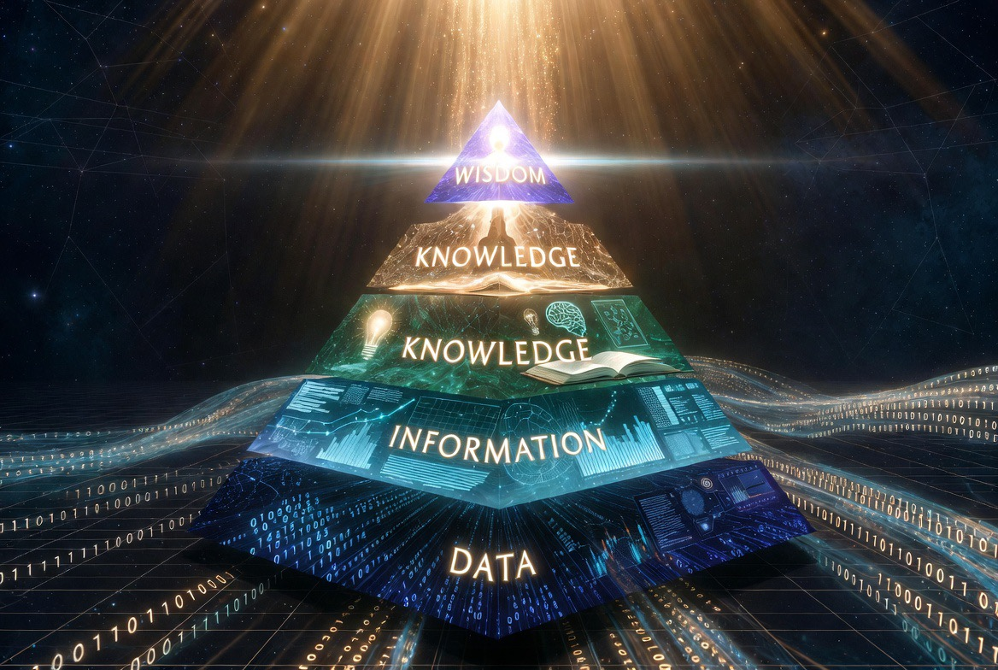
Data → Information → Knowledge → Wisdom
AI reaches Knowledge. It does not — and cannot — cross into Wisdom.
Back to words, back to meaning: Intelligence is the capacity to reason. Wisdom is the right application of that reason. The machine can be intelligent. It cannot be wise. It can feign wisdom — and we can either accept the counterfeit or reject it.
Crossing requires a die — a moral impression pressed into the output. AI has no such die.
Wisdom is not an advantage. It is a divine gift, assignment, and calling — unique to image-bearers.
"The beginning of wisdom is this: Get wisdom, and whatever you get, get insight." — Proverbs 4:7
Notes:
Angel Presents….
COIN CUE: Coin in hand.
The progression: Data → Information → Knowledge → Wisdom. (Definitions in speaker notes.)
DIKW definitions:
- Data — raw facts.
- Information — data in context.
- Knowledge — patterns and application.
- Wisdom — knowledge applied rightly, under a moral frame, in the fear of the Lord.
Personal stories (deliver live after defining Wisdom):
- Jobie: "I had everything man considered successful — I was successful at it — but I didn't have the wisdom of the Word."
- Angel: "I was taught the faith at a wonderful church — FBC Brandon — alongside many peers. Not all of us chose the same path. What made the difference?" Hold the question. The answer lands in Act 3 — the die.

Slide 17
Fear · Truth · Wisdom
This is more than just computer software. This is a cultural, spiritual, and generational moment.
Notes:
Angel delivers. Transition slide.
We will not inform you with fear, uncertainty, and doubt. We will inform you with Scripture.
"For God gave us a spirit not of fear but of power and love and self-control." — 2 Timothy 1:7
Speak briefly. We have said what the technology is. Now we ask how it lines up with Scripture.
Three pillars: Fear (the right kind), Truth (what Scripture says is real), Wisdom (what belongs only to image-bearers).
We will move briskly through Fear and Truth and spend the most time on Wisdom — because that is where the action is.
Reiterate: no FUD. Scripture, not marketing.

Slide 18
The Fears Are Not Irrational
Job displacement. Deception (deepfakes, synthetic voices). Loss of human connection. "Playing God." Surveillance and control. Manipulation of attention and belief.
These fears deserve honest engagement, not dismissal.
Fear, rightly ordered, is the doorway to wisdom — not the enemy of it.
Notes:
Angel delivers.
Six categories of fear. Acknowledge each briefly — most pastors have heard them from their own people or their own reflection.
Do not dismiss any of them. They are real. Jobs are displacing. Deepfakes are deceiving. Connection is thinning.
“The fear of the Lord is the beginning of wisdom." — Proverbs 9:10
Then Proverbs 9:10 — fear of the Lord is the beginning of wisdom. Ordered fear is not a problem; it is a doorway.
Transition: the deepest fear is not technological. It is theological.

Slide 19
The Deepest Fear Is Theological
If a machine can write a sermon, compose a prayer, offer counsel — what makes the human soul distinct?
That is exactly the right question.
Scripture gives us a clear answer. It is called Imago Dei.
"In him we live and move and have our being." — Acts 17:28
Notes:
Angel delivers.
Pastors feel this one personally. What makes the soul distinct if a machine can write a sermon, compose a prayer, counsel a heart?
The question is correct. The answer is Imago Dei.
Acts 17:28 anchor: "in Him we live and move and have our being." The machine does not live. It does not move in God. It has no being.
Set up Slide 18 — the Creator / creature order.

Slide 20
Creation Is Not Greater Than the Creator
"For by him all things were created... all things were created through him and for him." — Colossians 1:16–17
AI is a creation of a creation — clay shaped by hands God Himself shaped.
The moment we treat the model as more than clay, we have already re-run Romans 1:25.
Notes:
Angel Delivers
Romans 1:25 — "They exchanged the truth about God for a lie, and worshiped and served the creature rather than the Creator, who is blessed forever! Amen."
Read this live when you land "re-run Romans 1:25." That's the warning: every culture that has exalted its own creations above the Creator has done the same thing. We are not immune.

Slide 21
Imago Dei — The Image of God
"So God created man in his own image... male and female he created them." — Genesis 1:27
The image of God is not intelligence — it is personhood, moral agency, the capacity for relationship with the Creator.
No machine has this. No machine can have this.
AI does not diminish human dignity, unless we choose to let it.
Notes:
Angel delivers.
Genesis 1:27. The image of God is personhood, moral agency, the capacity for relationship with the Creator. NOT intelligence.
Many pastors quietly fear that AI diminishes human dignity by being "smarter" than us. Correct the fear: intelligence was never the image. Relationship with God was.
Say it firmly: No machine has this. No machine can have this.
AI does not diminish human dignity — we diminish our own dignity when we let it.

Slide 22
Dominion Is Stewardship, Not License
"Be fruitful and multiply and fill the earth and subdue it, and have dominion." — Genesis 1:28
Dominion is a commission, not a blank check.
Refusing to touch AI is not wisdom — it is the servant who buried the talent. (Matthew 25:14–30)
We must evaluate all technologies as tools (the Biblically correct role to ascribe to them) that can be used for good or abused for evil.
Notes:
Angel Delivers
Luke 12:48 — "Everyone to whom much was given, of him much will be required, and from him to whom they entrusted much, they will demand the more."
1 Corinthians 4:2 — "Moreover, it is required of stewards that they be found faithful."
Matthew 25:14–30 — The parable of the talents. The servant who buried his one talent was not condemned for losing it; he was condemned for refusing to put it to work. That is the posture we cannot adopt with AI.

Slide 23
Do Not Mistake the Prediction for the Voice of God
"Their idols are silver and gold, the work of human hands. They have mouths, but do not speak..." — Psalm 115:4–5
A model does not speak. It predicts.
The model has no die of its own — it presses out whatever die was loaded into it.
These models have the entire text of the Bible in every language and translation… they also have all of our sin within. They will mix both to generate an output.
”My sheep know my voice…”
Notes:
Angel Delivers.
COIN CUE: "Whose die pressed this coin?"
Psalm 146:3 — "Put not your trust in princes, in a son of man, in whom there is no salvation." The machine is the newest "prince." We do not place our trust there.
Matthew 7:18 — "A healthy tree cannot bear bad fruit, nor can a diseased tree bear good fruit." What comes out is downstream of what was pressed in. Name the die, name the output.

Slide 24
Intent Is the Vector — Babel or Great Commission
Intent is a vector — a direction plus a force. A task without clear intent has no direction; it drifts.
Intent has three parts (Commander's Intent – we’ll unpack it later):
Task — what you are doing
Purpose — why you are doing it
End state — what "done and right" looks like
Without all three, the same capability can point in opposite directions.
Babel (foolish outcomes) — capability + self-interested intent: "Come, let us build ourselves a city and a tower... let us make a name for ourselves." — Genesis 11:4
Great Commission (wise outcomes) — capability + God-centered intent: "Go therefore and make disciples of all nations." — Matthew 28:19
Same capability. Opposite vectors. Every AI interaction points one way or the other — and the direction is set by the user's heart intent.
Notes:
Jobie Delivers./Angel Quantifies
Define vector clearly. A task without clear intent has no direction — it drifts. Intent = direction + force.
Task + Purpose + End State = the shape of aligned intent. Without all three, the same capability can point two opposite ways.
Babel and the Great Commission had the same raw capability (humans building things). They had opposite intent. Babel: make a name for ourselves. Great Commission: make disciples in His name.
Every AI interaction is a mirror of the heart. The prompt is the intent. Ruthless clarity on the prompt prevents Babel-shaped output.

Slide 25
All Models Are Wrong — Some Are Useful
A first-principle from statistics that travels well beyond it: "All models are wrong, but some are useful." — George E. P. Box, 1976.
Models are man-made attempts to explain reality — sometimes even the divine.
Every theology, every framework, every AI system is a model — a finite attempt to compress an infinite reality.
A useful model knows the die it was pressed from. It knows its source of truth — and names it plainly.
This humility is structural to Christian thought. It is also the only honest posture toward AI.
Notes:
Angel Delivers.
COIN CUE: Set the coin on the lectern, still visible.
"For now we see in a mirror dimly." — 1 Corinthians 13:12
Isaiah 55:8–9 — "For my thoughts are not your thoughts, neither are your ways my ways, declares the Lord. For as the heavens are higher than the earth, so are my ways higher than your ways and my thoughts than your thoughts."
If our best theology is partial, every other model we build is more partial still. Humility is not an add-on to Christian thought; it is structural. The same humility is the only honest posture toward an AI model — ours or anyone else's.

Slide 26
Applying Wisdom Means Asking the Right Questions…
Not "Is AI good or evil?" — it is a tool. A hammer builds a house or breaks a window.
Ask instead:
Does this use honor God?
Does this serve people or exploit them?
Does this strengthen human connection or replace it?
Am I being a faithful steward of this capability?
Am I being honest about what AI produced vs. what I created?
These are die-shape questions. They assume you already know the truth you are pressing into every use.
Notes:
Jobie Delivers.
COIN CUE: Pick the coin back up.
Reframe: "Is AI good or evil?" is the wrong question. A hammer builds a house or breaks a window. The question is the hand on the hammer.
The right questions assume you already know your die. You cannot ask them honestly without first knowing what truth you are pressing into the work.
Walk the five questions slowly. Each one is diagnostic.
"If any of you lacks wisdom, let him ask God." — James 1:5
James 1:5. When you do not know, ask God — not the model.
Transition into Act 3: the responsibility is ours.

Slide 27
The Discipline You Already Have…
A grateful word for my pastor, Mike Grover, at Fellowship Baptist Church. Last Wednesday night in Bible study, he preached on how to study a word in Scripture. Providentially timed for this moment.
You already know this discipline. Seminary taught it to you: weigh author intent, test against the whole canon, resist private readings, stay humble about what you do not yet understand.
The same discipline — point for point — applies to every AI tool’s output.
You do not need a new framework. You need to point the one you already have.
"Test (dokimazete) everything; hold fast what is good." — 1 Thessalonians 5:21
Notes:
Angel delivers.
Pastor Mike Grover call-back — Wednesday night at Fellowship Baptist, the word-study framework for Scripture. Brief, grateful, personal.
"If any of you lacks wisdom, let him ask God." — James 1:5
Pastors learned the method in seminary. The same method applies to every AI output — weigh the author's intent, test against the whole canon, resist private readings, stay humble.
You do not need a new framework. You need to aim the one you already have.
1 Thessalonians 5:21 is the New Testament command for exactly this discipline: test everything; hold fast what is good.
Set up the reveal.

Slide 28
We Are the Die…
Throughout this hour we have used one word again and again: die.
A die is the metal stamp a mint uses to press a pattern into every coin. No die, no coin. No coin that matches any other. (dokimazete)
You may have heard use and assumed the die was something technical — a system prompt, a guardrail, a filter of pre-approved truth we load into the machine.
The die is not a system prompt. The die is you, me.
You — image-bearers of the Creator of the universe, the pinnacle of what God has made — carry the calling to be the standard.
"Then God said, 'Let us make man in our image, after our likeness.'" — Genesis 1:26
The Great Commission has always been a minting operation. We are the die pressed into the next generation.
The responsibility falls on us — to wield this tool responsibly, and to equip others to do the same.
A die that refuses to press is an impression that ceases to exist.
Notes:
Jobie Delivers – Coin Hobby (TEST THE COIN / CASH REGISTER WITH MARBLE SLAB / TUNING FORK)
COIN CUE — THE REVEAL: Pull out a second coin. Hold both up. "These coins look identical because they came from the same die. The Great Commission is a minting operation. We are the die."
Isaiah 49:16 — "Behold, I have engraved you on the palms of my hands; your walls are continually before me." God carries our image; we carry His. That is the shape of the die we are pressed from.
Matthew 28:18–20 — the Great Commission, the minting operation: "All authority in heaven and on earth has been given to me. Go therefore and make disciples of all nations, baptizing them in the name of the Father and of the Son and of the Holy Spirit, teaching them to observe all that I have commanded you."
1 Peter 5:2–3 — the shepherd as die: "Shepherd the flock of God that is among you, exercising oversight... being examples to the flock." The shepherd is the pattern pressed into the next generation.
Delivery: hold both coins here. This is the emotional apex. Slow down.

Slide 29
What Wise Use of AI Looks Like
Using it as a tool:
Multiplying ministry capacity — drafting communications, summarizing meetings, research.
Increasing accessibility — translation, transcription, serving members with disabilities.
Improving stewardship — better analysis for budgeting, outreach, planning.
Freeing up time for what only humans can do — presence, prayer, pastoral care, relationship.
Always with transparency, humility, and human oversight.
"Commit your work to the Lord, and your plans will be established." — Proverbs 16:3
Notes:
Jobie delivers.
Each bullet is a category pastors can pilot this week — safely, with oversight.
- Multiplying capacity — drafting communications, summarizing meeting notes, research. NOT sermon drafting. Admin.
- Accessibility — translation for Spanish speakers, transcription for hearing-impaired. Gospel-serving.
- Stewardship — budgeting analysis, outreach analytics. Better decisions, less friction.
- Freeing time for presence, prayer, pastoral care — the work only humans can do.
Proverbs 16:3. Commit the plans to the Lord — then let the tool serve the plan.

Slide 30
What Makes AI Dangerous Without Wisdom
Wielding the tool as a replacement or a human-equivalent:
Using AI-generated content without review or discernment.
Replacing human pastoral care, counseling, or spiritual direction with AI.
Trusting AI output as authoritative on theological matters.
Creating a dependency that atrophies human skill, judgment, and relationship.
Allowing AI to shape doctrine or interpret Scripture without trained human oversight.
"There is a way that seems right to a man, but its end is the way to death." — Proverbs 14:12
Notes:
Jobie delivers.
Five common failure modes. Each deserves its own Part 2 session — we will not open them fully today.
- Using output without review.
- Replacing pastoral care with a chatbot.
- Trusting AI on theology or Scripture interpretation.
- Building dependency that atrophies human skill, judgment, and relationship.
- Letting AI shape doctrine without trained human oversight.
Proverbs 14:12 — "a way that seems right... but its end is death." The seductive danger is exactly the way that feels right.

Slide 31
How AI Should Never Be Used
To deceive — deepfakes, synthetic voices, fabricated content presented as real.
To replace the irreplaceable — the Holy Spirit, the human soul, the pastoral relationship.
To manipulate — exploiting psychological patterns in congregation members.
To avoid accountability — hiding behind "the AI said it" instead of owning decisions.
To generate or claim divine authority — AI does not prophesy; it identifies patterns.
"You shall not bear false witness." — Exodus 20:16
Notes:
Jobie delivers.
Five "never" lines. These are non-negotiables.
- Deceive — deepfakes, synthetic voices, fabricated content. Violates the ninth commandment.
- Replace the irreplaceable — Holy Spirit, human soul, pastoral relationship.
- Manipulate — exploit psychological patterns in members.
- Avoid accountability — "the AI said it" is not a defense.
- Claim divine authority — AI does not prophesy; it identifies patterns. Make that distinction clear.
Exodus 20:16 — "You shall not bear false witness." The commandment predates the technology. It still applies.

Slide 32
Commander's Intent — The Directed Vector
The military wields power not because of technology, but because of Commander's Intent + effective communication.
The Directed Vector:
Desired end state — what does "done and right" look like?
Constraints — what may not be violated?
Success criteria — how do we know we got there?
Underlying why — the reason the mission exists at all.
This is how you give AI intent — and how you discern its output.
"Write the vision; make it plain on tablets, so he may run who reads it." — Habakkuk 2:2
Notes:
Jobie delivers from 27 years of military experience.
Commander's Intent is how the U.S. military wields power without needing perfect communication or perfect technology.
The Directed Vector has four parts: End State, Constraints, Success Criteria, Underlying Why.
This is how you give AI intent — AND how you discern its output. Pastors will recognize it as a leadership framework they already use in shepherding a congregation.
Habakkuk 2:2: write the vision plain so he may run who reads it. That is the end state. That is the intent.

Slide 33
How to Effectively Wield AI as a Tool
Three Things to Write on the Wall
Know Your Why — without it, output is noise.
Effective Clarity — say exactly what you mean. Specific, Measurable, Actionable, Relevant, Time-Based (SMART) Criteria
Reduce Ambiguity — remove what the model can misread.
Operator disciplines. Berean disciplines.
"Let what you say be simply 'Yes' or 'No'; anything more than this comes from evil." — Matthew 5:37
Notes:
Jobie Delivers.
Three words. Write them on the wall.
- Ruthless Clarity — say exactly what you mean.
- Reduce Ambiguity — remove what the model can misread.
- Know Your Why — without it, any output is noise.
These are operator (warrior) disciplines. They are also preacher disciplines. Same DNA.
Matthew 5:37 — "let your yes be yes." Jesus gave us the discipline first.

Slide 34
Three Things to Do Today
Try it with intent — open ChatGPT or Claude. Pick a real task. Write the prompt with ruthless clarity. Evaluate the output with the same care you would apply to a verse in sermon prep. You cannot lead your people through something you have not touched.
Name your die — establish guardrails — before you use AI in ministry, write down what truth you are pressing into it. Start the leadership conversation. You do not need a full policy today; you need a framework for wise decisions.
Equip the flock — start the conversation — your congregation is already looking in the mirror at home, work, and school. Your church must be a safe place to ask questions, express fears, and seek wisdom. Do not let the culture define AI for your people.
Notes:
Angel closes Act 3.
Action list. Not after more study — today.
1. Try it with intent. Open ChatGPT or Claude. Pick a real task. Write the prompt with ruthless clarity. Evaluate the output the way you would evaluate a verse in sermon prep.
2. Name your die — establish guardrails. Before you use AI in ministry, write down the truth you are pressing into it. If you cannot name the die, do not mint a coin.
3. Equip the flock — start the conversation. Your congregation is already in the mirror. Be the place they can ask questions. Do not let the culture define AI for them.
James 1:22 — "be doers of the word, not hearers only." Tomorrow's sermons do not wait for a seminar.
"Be doers of the word, and not hearers only, deceiving yourselves." — James 1:22

Slide 35
The Three Takeaways, Restated
What it is — Augmented Intelligence. A mirror, a pattern-matcher, a memory-builder. It reaches Knowledge. It does not cross into Wisdom.
How it aligns — Fear rightly ordered opens wisdom. Truth reminds us creation is not greater than the Creator. Wisdom belongs to the image-bearer, and intent is the vector — Babel or Great Commission.
Our responsibility — We are the die. Blind reliance is where deception takes root. We wield the tool; we equip others; we do not surrender the calling.
"All Scripture is breathed out by God and profitable for teaching, for reproof, for correction, and for training in righteousness, that the man of God may be complete, equipped for every good work." — 2 Timothy 3:16–17
Notes:
Angel or Jobie. Bookend the hour.
Match Slide 4. If nothing else:
- What it is — Augmented Intelligence. Mirror. Pattern-matcher. Memory-builder. Reaches Knowledge, never Wisdom.
- How it aligns — Fear rightly ordered. Truth (creation is not greater than Creator). Wisdom (image-bearer's calling).
- Our responsibility — We are the die. We wield. We equip. We do not surrender.
2 Timothy 3:16–17 — the man of God, equipped for every good work. This is the equipping.

Slide 36
What's Coming Next — The Series
Today was the foundation. The series builds from here:
Part 2 — Planning Practical Uses. What does a wise deployment actually looks like? What implications can the technology have on your operations and ministry? What good could you do with it? What risks are associated with it?
Part 3 — Implementing Your Plan. Do you have a Ministry Operating System? Is your ministry intentional?
This is a journey. Today is step one.
Notes:
Angel wraps.
Part 1 was the foundation. Two more parts planned:
- Part 2 — Practical Uses (+ Risks): sermon research, communications, accessibility, administration — with specific risks and guardrails.
- Part 3 — How to Get Started: policy template, tooling recommendations, staff training, first-90-days implementation plan.
Dates are not set yet — TBBA and DataCorps will schedule in the coming weeks. Stay connected via email.

Slide 37
Q&A + Contact
Questions. Conversation. Pushback welcome.
DataCorps Technology Solutions, Inc. "Honor God, Protect Data, Be Awesome”
angel.rojas@datacorps.com jobie.roach@datacorps.com www.datacorps.com
(813) 655-9247
Notes:
Open the room.
Questions, concerns, disagreements, pushback all welcome.
If you would rather not ask publicly, come talk to us after. We will stay as long as anyone wants to talk.
Contact: datacorps.com · angelrojasjr.com. Email is welcome; both of us will respond.
Close with the DataCorps mission: "Honor God, protect our clients using technology, and be awesome." Leave it ringing.

Slide 38
